Slide 1
Security and File Permission
Amit Patel

Slide 2
INTRODUCTION
In Unix, everyone who logs onto the system is called a user.
It is known to the system by user-id.
Some user have more capabilities than user is called super user.
User can be organized into group.

Slide 3
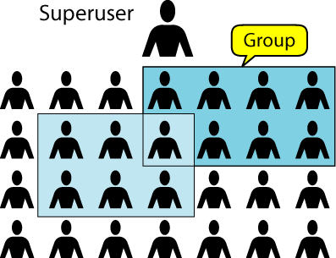
Users and Groups

Slide 4
group command
Used to determine user’s group.
If enter the command with no user-id, the system respond with your group.
If enter the command with user-id, it returns the user’s group.
If user belongs to multiple groups, all of them will be listed.

Slide 5
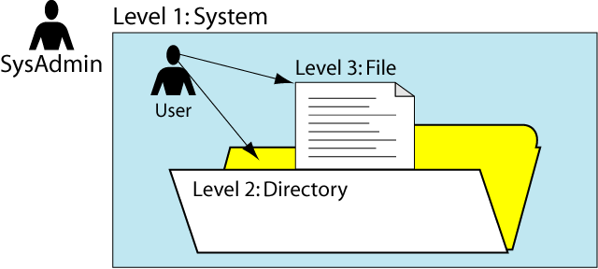
Security Levels.
There are three level of security: system, directory, and file.
The system security is controlled by a superuser.
The directory and file securities is controlled by the users who own them.

Slide 6
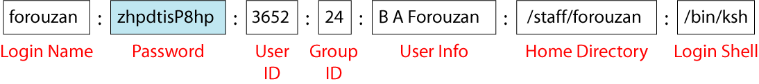
Security
System security controls who is allowed to access the system.
When the system administrator opens an account for you, he creates an entry in the system password file, “etc\passwd\”.
You can look at this file, but only a super user can change it.
Content of an entry in our password file are follow.
Passwords are encrypted. Userid is unique number between 0 to 65535, where as Group id is between 100 to 65535.

Slide 7
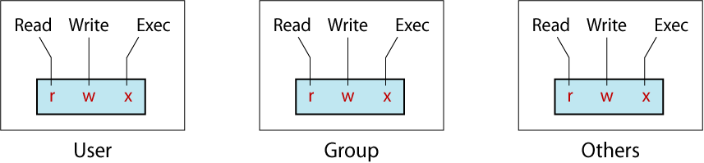
Permission Codes
Both the directory and file security level use a set of permission code to determine who can access and manipulates a directory and file.
It is divided into three sets of codes.
The first set contains the permission of the owner of the directory or file.
The second set contains the group permission for the member of group.
The third set contains the permission for everyone.
The code for each set is a triplet representing read( r ) , write ( w ) and execute ( x ).

Slide 8
Permission Codes
Read( r ) indicates that the user can read the file or directory.
Write( w ) indicates that the user can change the file or directory.
Execute ( x ) has different meaning for files and directory.
For file, It indicates that the file is program or script that can be executed.
For Directory, It allow access or traverse to the directory.
PERMISSION | READ ( r ) | WRITE ( w ) | EXECUTE ( x )
Directory | Read content of directory. | Add or delete files in directory using command. | Reference or Traverse directory.
File | Read or copy files in directory | Change or delete files. | Run executable files.

Slide 9
Directory Level Permission
Read Permission( r )
When user have read permission, they can read the directory, which contain the name of the files and sub-directories and attributes.
Users can display the name and attributes using list (ls) command.
Everyone is given read permission for directories.
If you don’t want other user to see what files you have in directories , you remove read permission.

Slide 10
Directory Level Permission
Write Permission( w )
When user have write permission, they can add or delete entries in directory.
Means User can copy a file from another directory, move a file to or from directory or delete a file.
If you grant this permission, other user can change content of your directory so its very dangerous.

Slide 11
Directory Level Permission
Execute Permission( x )
Execute permission sometimes called search permission.
It allows you to reference a directory, as in a pathname or file read or move to directory using “cd” command.
To reference, a subdirectory or file under a directory, you must have execute permission to all directories in absolute pathname.
The user permission for directories generally include read and execute.
To grant read without execute permission is a contradiction because without execute no one, including owner may access the directory for reason.
Directory read permission allows you to read files in a directory, but only if you also have execute permission. Without execute permission, no access is allowed to a directory or any of its sub-directories.

Slide 12
File Level Permission
Read Permission( r )
When user have read permission, they can read or copy a file.
Private files should be read only by the user.
Group files should be readable by anyone in the group.
Write Permission( w )
When user have write permission, they make changes or deleted.
Execute Permission( x )
With execute permission, user can execute programs, utilities and script.

Slide 13
ls –l command
Check the following example to understand the permission.
$ ls –l test.txt
-rw-r--r-- 1 sai sai 272 Mar 17 08:22 test.txt
In the above example:
User (sai) has read and write permission
Group has read permission
Others have read permission
Three file permissions:
read: permitted to read the contents of file.
write: permitted to write to the file.
execute: permitted to execute the file as a program/script.

Slide 14
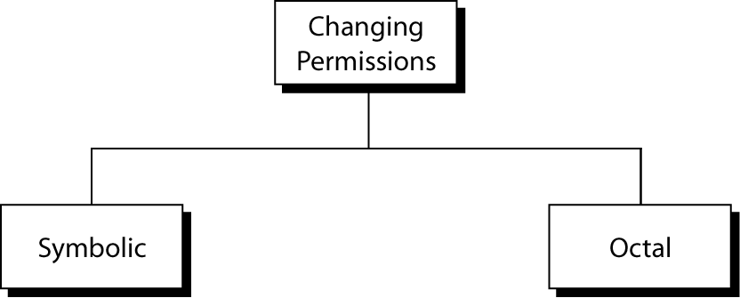
Changing Permission
When a directory or file is created, the system automatically assign default permission.
The owner of the directory or file can change them.
“chmod” command is used to changed the default permission.
There are two ways/mode to change the permissions.

Slide 15
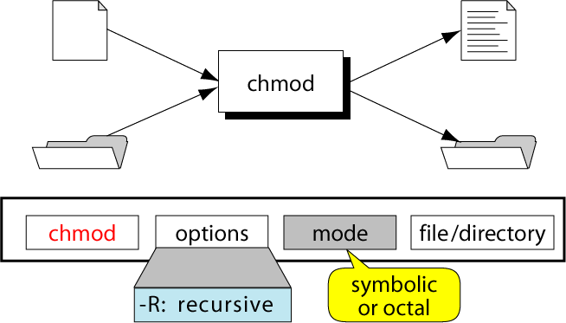
The chmod Command
To change the permissions we use the chmod command.

Slide 16
Symbolic OR Relative Permission
Definition: The permission mode in which we signify what you want, to add or remove and to whom with single letter abbreviations is known as relative permission
A chmod command with this form of syntax consists of at least three parts from the following lists:
Access Class (Who) | Operator | Access Type(Permission)
u (user) | + (add access) | r (read)
g (group) | - (remove access) | w (write)
o (other) | = (set exact access) | x (execute)
a (all: u, g, and o)

Slide 17
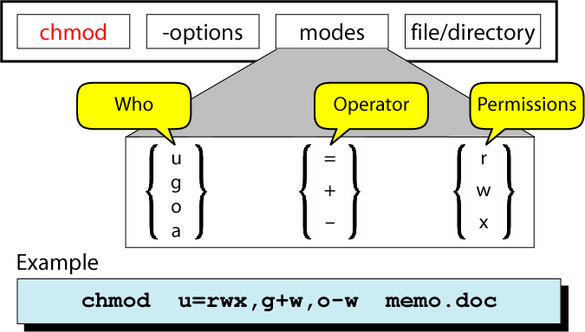
Symbolic chmod Syntax

Slide 18
Symbolic OR Relative Permission
Who - who specifies which permission group we are changing. Possible values are Listed in table
Operator - specifies which action to take. Possible values are
+ - Adds the permission
- - Removes the permission
= - Sets the permission exactly
Permissions - specifies which permission bit to change. The ones we are concerned with are:
r - the read bit
w - the write bit
x - the execute bit

Slide 19
Symbolic OR Relative Permission
We can specify up to 3 symbolic modes in one chmod command.
Each set of symbolic codes must be separated by comma, there can be no spaces.
Operator are use to add, remove or set the permission to user, group or all.
The permission are represented by their symbolic letters: r, w ,e
We can also specify multiple files or files with wildcards.

Slide 20
Symbolic Chmod Command
COMMAND | INTERPRETATION
chmod u=rwx file | Set read( r ), write( w ) and execute( x ) for user.
chmod g=rx file | Set only read( r ) and execute( x ) for group denied write permission.
chmod g+x file | Add execute( x ) permission for group, read and write unchanged.
chmod a+r file | Add read( r ) permission for all users, other permission are unchanged.
chmod o-r file | Remove read permission from other users.
chmod u+x * | Change execute permission only on directories.
chmod u+r, g+x file | Set read permission to user and execute permission to group for file

Slide 21
Octal OR Absolute Permission
Definition: The mode in which you signify permission through numbers is known as Absolute permission.
A faster way to enter permission is to use the octal equivalent of the codes.
In this case, you specify a set of three numbers that together determine all the access classes and types.
Difference: In symbolic modes, where you need to specify only where want to change. With octal codes, you must completely represent all of the user codes each time.
In an octal code, there are 3 bit positions.
The three numbers are specified in the order: user (or owner), group, other.
Each number is the sum of values of permission on files.

Slide 22
Octal Chmod Command
Numeric values for the read, write and execute permissions are as follows.
read :4
write :2
Execute: 1
Total of all three binary position is 7 which is maximum value that can be stored in one octal digit.

Slide 23
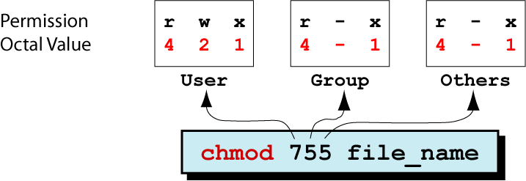
Octal chmod Commands
Here we set all permission to user, only read and execute permission to group and others.

Slide 24
Octal Chmod Command
Example 2: Set read, write and execute permission to user, read and write permission to group and only read permission to other.
$ chmod 764 file1.
For example 3: Give read, execute ( 4 + 1 = 5 ) to user and read (4 ) to group, and nothing ( 0 ) to others.
$ chmod 540 filename

Slide 25
User Mask
Definition: User mask is a 4 digit octal system variable which is used initially set permission for a directory of files.
Defined initially by system administrator when user account is created.
It is use to determine the file permission for newly created files.
It can be used to control the default file permission for new files.
It contains the octal settings for the permissions that are to be removed from the default when a directory or file is created.
Default Permission :
For Directory: 777
For File: 666

Slide 26
User Mask
When new directory or file is created, the number in the mask is used to set the default permission.
You can change the settings by creating mask entry in you login file.
You can setup umask in /etc/bashrc or /etc/profile file for all users by appending following line
Umask 222

Slide 27
MASK | DIRECTORY PERMISSION | FILE PERMISSION
000 (Public) | 777 (rwx rwx rwx) | 666 (rw- rw- rw-)
011 (Public) | 766 (rwx rw- rw-) | 666 (rw- rw- rw-)
022 (Write protected) | 755 (rwx r-x r-x) | 644 (rw- r-- r--)
007 (Project private) | 770 (rwx rwx ---) | 660 (rw- rw- ---)
077 (Private) | 700 (rwx --- ---) | 600 (rw- --- ---)

Slide 28
umask(User Mask) command
To display the current user mask settings, use the umask command with no argument.
$ umask
000
To set it, use the command with the new mask setting.
$ umask 022
$ umask
022

Slide 29
Changing Ownership and Group
Every directory and file has an owner and group.
When we create a directory or file, we are the owner and our group is the group.
Sometimes you need to change the owner of a file, such as when someone leaves an organization or a developer creates an application that needs to be owned by a system account when it’s in production.
There are 2 command used to change the owner and group.
chown (Change Owner)
chgrp (Change Group)

Slide 30
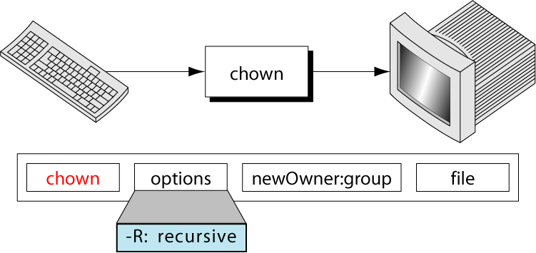
chown Command
Only a current owner or a superuser may change the ownership.
The new owner is a login name of a user id.
The group is optional. The group is a group name or a group id.

Slide 31
chown Command
You can specify either the login name or the numeric UID for the new owner of the file:
$ chown dan newfile
$ ls -l newfile
rw-rw-r-- 1 dan rich 0 Sep 20 19:16 newfile
Simple. The chown command also allows you to change both the user and group of a file:
$ chown dan.shared newfile
$ ls -l newfile
-rw-rw-r-- 1 dan shared 0 Sep 20 19:16 newfile

Slide 32
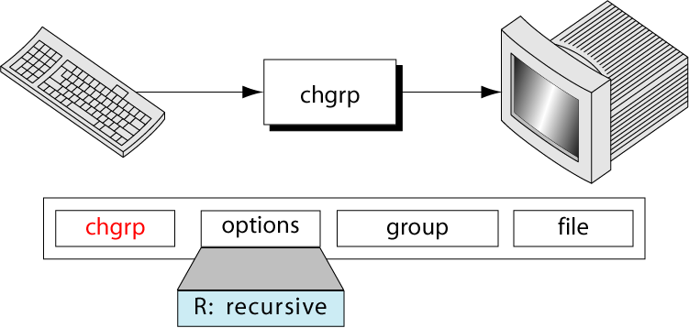
chgrp Command
To change the group without changing the owner, you use the change group (chgrp) command.

Slide 33
chgrp Command
To change the group without changing the owner, you use the change group (chgrp) command.
$ chgrp shared newfile
$ ls -l newfile
-rw-rw-r-- 1 rich shared 0 Sep 20 19:16 newfile
Now any member in the shared group can write to the file. This is one way to share files on a Unix system.

Slide 34
Sticky Bit
It is used mainly used on folders in order to avoid deletion of a folder and its content by other user though he/she is having write permissions.
If Sticky bit is enabled on a folder, the folder is deleted by only owner of the folder and super user(root).
This is a security measure to suppress deletion of critical folders where it is having full permissions by others.

